Slide 1
Company Inc
Keys To Growth

Slide 2
Key Factors For Profit Growth
Ship Goods to In Demand Routes to Maximize Sales
Deliver In Demand Products to Minimize Weekly Returns
Remove products with negative sales

Slide 3
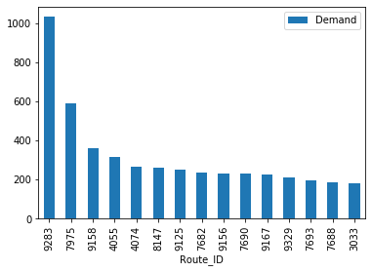
Demand is simply Unit Sales minus Unit Returns Route demand goes as low as 2.25 for some routes Avg demand is 53
Avg Weekly Demand By Route ID

Slide 4
Route Solution
Send More Goods To These Routes To Test Their Demand
Routes like 8147, 7682, and 7690 had no returns for any week
Using the routes with no returns ensures profit
Incrementally increase goods to these areas until you find their max profits

Slide 5
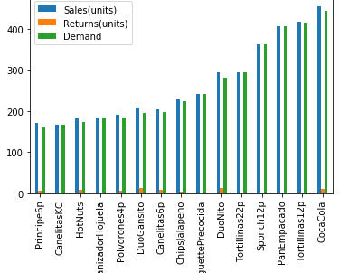
Most Popular Goods
Prioritize Shipping these products to as many locations as possible
Increase units in any areas not getting returns

Slide 6
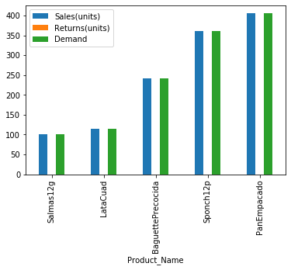
Potentially Popular Goods
These Goods showed no returns
Increase their shipment sizes until they start to show returns
Could possibly be your highest selling goods

Slide 7
Least Popular Goods
​
Goods that lose money weekly
Remove these products for profit
Free Up Truck Inventory Space
 | Sales(units) | Returns(units) | Demand
Product_Name
Paletinapara | 0.000000 | 250000.000000 | -250000.000000
MenthoPlus | 66.666667 | 207.666667 | -141.000000
MiniGansito | 66.125000 | 146.750000 | -80.625000
ComboTost | 0.000000 | 44.000000 | -44.000000
StarGumYerbabuena | 0.000000 | 21.666667 | -21.666667
DuoPlativolos | 3.178571 | 20.130952 | -16.952381
Spirrones25g | 13.800000 | 23.800000 | -10.000000
BolsitaSurtido | 0.000000 | 8.000000 | -8.000000
MaxTwo | 0.000000 | 7.000000 | -7.000000
FruttimaniaManzana | 0.000000 | 5.000000 | -5.000000
DuoPolvoron | 0.000000 | 4.000000 | -4.000000
DuoSilueta | 0.000000 | 4.000000 | -4.000000
Tostado2pq | 1.000000 | 3.000000 | -2.000000
TarimaGalletero | 0.000000 | 2.000000 | -2.000000
CharolaNito | 2.000000 | 3.000000 | -1.000000

Slide 8

Conclusion
Whenever Possible Ship Your Most Popular Goods to Your Most Popular Routes
As Long as Your Return is Minimal you’re Maximizing Profits
Remove Goods Losing You Money

